Slide 1
18CSE15-DATA WAREHOUSING AND MINING

Slide 2
OPEN SOURCE DATA MINING
AATIF MUHAMMAD.A
18TUCS002
III-CSE-’A’

Slide 3
CONTENTS:
INTRODUCTION
DATA MINING
OPEN SOURCE SYSTEMS
FEATURES OF OPEN SOURCE DATA MINING
OPEN SOURCE DATA MINING TOOLS
ADVANTAGES OF OPEN SOURCE DATA MINING
DISADVANTAGES OF OPEN SOURCE DATA MINING
FUTURE IDEAS FOR BETTER USAGE
CONCLUSION

Slide 4
INTRODUCTION:
Open source data mining software represents a new trend in data mining research, education and industrial applications, especially in small and medium enterprises .
With open source software an enterprise can easily initiate a data mining project using the most current technology.
Often the software is available at no cost, allowing the enterprise to instead focus on ensuring their employees can freely learn the data mining techniques and methods.
Open source ensures that employees can understand exactly how the algorithms work by examining the source code, if they so desire, and can also ﬁne tune the algorithms to suit the speciﬁc purposes of the enterprise.
However, diversity, instability, scalability and poor documentation can be major concerns in using open source data mining systems.

Slide 5
OPEN SOURCE SYSTEMS:
Open Source refers to any program whose source code is made available for use or modification as users or other developers see fit.
Open source software is usually developed as a public collaboration and made freely available.
The software being distributed must be redistributed to anyone else without any restriction.
Unlike closed source licenses which aim to limit your rights, open source software aims to give you the right to do whatever you please with the software.
It is available in source code form without additional cost, meaning users can view the code that comprises the software and make any kind of changes to it they want.
The source code can be repurposed into other new software, meaning anyone can take the source code and distribute their own program from it.

Slide 6
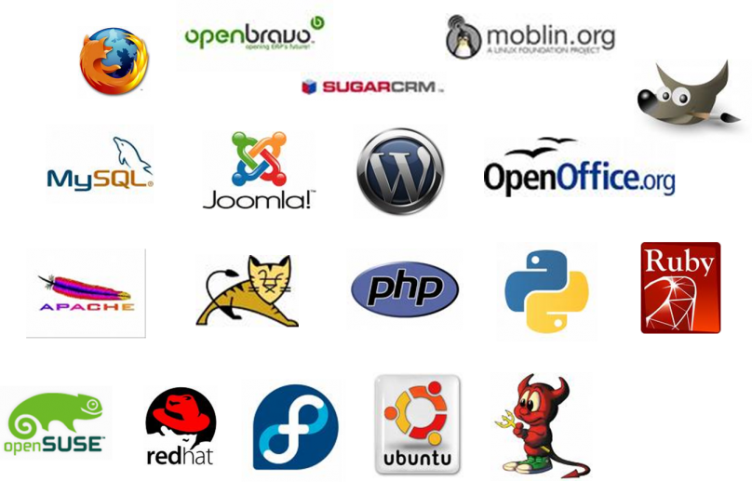
OPEN SOURCE SYSTEMS:

Slide 7
DATA MINING :
Data mining refers to the process of extracting useful information from large amounts of data.
Data mining involves exploring and analyzing large blocks of information to glean meaningful patterns and trends.
Data mining is widely used to solve many business problems, such as customer proﬁling , customer behavior modeling , credit scoring, product recommendation, direct marketing etc.
For example data mining can be used by corporations for everything from learning about what customers are interested in or want to buy to fraud detection and spam filtering.
Data mining programs break down patterns and connections in data based on what information users request or provide.

Slide 8
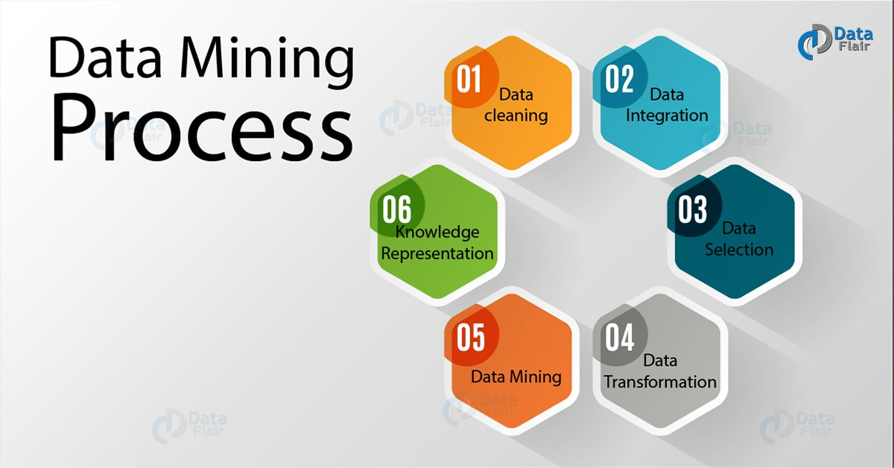
DATA MINING:

Slide 9
DATA MINING:
Each data mining process is composed of a sequence of data mining operations, each implementing a data mining function or algorithm. We can categorize data mining operations into the following groups:
Data Understanding Operation: Access data from various sources and explore the data to become familiar with it and to “discover” the ﬁrst insights.
Data Preprocessing Operation: Generally involves data ﬁltering, cleaning, and transformation, to construct the ﬁnal dataset for the modeling operations.
Data Modeling Operation: Implements the data mining algorithms, such as k-means clustering. These operations are used to build data mining models.
Evaluation Operation: Used to compare and select data mining models by choosing the best one. Common operations include confusion matrix, lift chart, gain chart, cluster validation and visualization.
Deployment Operation: Involves deploying a data mining model to make decisions, such as using a predictive model to predict potential campaign model to score customers for a target campaign .

Slide 10
FEATURES OF OPEN SOURCE DATA MINING:
There are some important features of data mining, they are:
Ability to access various data sources: Data comes from databases, data warehouses, and ﬂat ﬁles in diﬀerent formats. A good system will easily access diﬀerent data sources.
Data pre-processing capability: Preprocessing occupies a large proportion of the time in a data mining process. Data preparation is often the key to solving the problem. A good system should provide various data preprocessing functions tasks easily and eﬃciently.
Integration of diﬀerent techniques : There is no single best technique suitable for all data mining problems. A good data mining system will integrate diﬀerent techniques (preprocessing functions and modelling algorithms), providing easy access to a wide range of diﬀerent techniques for diﬀerent problems.

Slide 11
FEATURES OF OPEN SOURCE DATA MINING:
Ability to operate on large datasets :Commercial data mining system, such as SAS Enterprise, can operate on very large datasets. This is also very important for open source data mining systems, so scalability is a key characteristic.
Good data and model visualization : Experts and Freshers alike need to investigate the data and understand the models created.
Extensibility: With new techniques and algorithms it is very important for open source data mining systems to provide an architecture that allows incorporation of new methods with little eﬀort. Good extensibility means easy integration of new methods.
Interoperability with other systems : Open standards means that systems (whether open or closed source) can interoperate. Interoperability includes data and model exchange.
Active development community : An active development community will make sure that the system is maintained and updated regularly.

Slide 12
OPEN SOURCE DATA MINING TOOLS:
WEKA: The original non-Java version of WEKA primarily was developed for analyzing data from the agricultural domain. With the Java-based version, the tool is very sophisticated and used in many different applications including visualization and algorithms for data analysis and predictive modeling.
RAPIDMINER: Written in the Java Programming language, this tool offers advanced analytics through template-based frameworks. Users hardly have to write any code. Offered as a service, rather than a piece of local software, this tool holds top position on the list of data mining tools.
ORANGE: Orange is a great data mining tool for beginners as well as for expert data scientists. It’s user interface can focus on data analysis instead on laborious coding, making a construction of complex data analytics pipelines simple.

Slide 13
OPEN SOURCE DATA MINING TOOLS:
R-PROGRAMMING: R is a programming language and free software developed by Ross Ihaka and Robert Gentleman in 1993. R possesses an extensive catalog of statistical and graphical methods. It includes machine learning algorithms, linear regression, time series, statistical inference to name a few. Most of the R libraries are written in R, but for heavy computational tasks, C, C++ and Fortran codes are preferred. R is not only entrusted by academic, but many large companies also use R programming language, including Uber, Google, Airbnb, Facebook and so on.
KNIME: Data preprocessing has three main components: extraction, transformation and loading. KNIME does all three. It gives you a graphical user interface to allow for the assembly of nodes for data processing. It is an open source data analytics, reporting and integration platform. KNIME also integrates various components for machine learning and data mining through its modular data pipelining concept and has caught the eye of business intelligence and financial data analysis.

Slide 14
OPEN SOURCE DATA MINING TOOLS:
DATAMELT: DataMelt is an environment for numeric computation, data analysis and data visualization. DataMelt is designed for analysis of large data volumes ("big data"), data mining, statistical analyses and math computations. The program can be used in many areas, such as natural sciences, engineering, modeling and analysis of financial markets.
RATTLE: Rattle, expanded to ‘R Analytical Tool To Learn Easily’, has been developed using the R statistical programming language. The software can run on Linux, Mac OS and Windows, and features statistics, clustering, modelling and visualization with the computing power of R.
APACHE MAHOUT: Mahout is primarily a library of machine learning algorithms that can help in clustering, classification and frequent pattern mining. It can be used in a distributed mode that helps easy integration with Hadoop.

Slide 15
ADVANTAGES OF OPEN SOURCE DATA MINING:
Supporting multi-platform :GNU/Linux, Mac, and MS/Windows are supported by almost all systems.
Good human interaction :Almost all these systems support some degree of human guided discovery process, and more than half of them oﬀer workﬂow style processes. KNIME, Orange and Weka provide drag-and-drop style case constructing.
Plentiful algorithms :Each system has integrated plentiful algorithms for data preprocessing and modeling. Some contain more than 100 algorithms. However, this often actually works against the usefulness of the tool, as it confuses the business user.
Reuse of cases :All of them can reuse the cases. KNIME and Rattle can export models in PMML format, which means that they can share models with other PMML compliant applications.
Simple extensibility :Most systems can integrate new operations in the form of plug-ins, some of which can be called in scripts.

Slide 16
DISADVANTAGES OF OPEN SOURCE DATA MINING:
Lack of support for diverse data resources: KNIME, and Rattle support most file formats and relational databases through ODBC and JDBC . Some systems only focus on a smaller number of ﬁle formats.
Diﬃculty with large volumes of data: Real world applications often deliver very large datasets, with millions of rows. Most open source data mining systems are great for demonstrating and comparing the range of algorithms on smaller datasets but there has not been a focus on dealing with very large datasets. This limitation hinders the use of open source data mining systems in real applications, especially in business.
Poor documentations and services: During the investigation, we found that most of these systems have poor documentations, of limited use for a novice user wanting to quickly master the systems. Also support services is a serious issue, relying on the good will of a community of users.

Slide 17
FUTURE IDEAS FOR BETTER USAGE:
Supporting various data sources: A good open source data mining system should support most commonly used data sources, such as the open source and commercial databases, csv ﬁles, and user deﬁned formats.
Providing high performance data mining: Most open source data mining system can’t operate on large volumes of data. To oﬀer high performance data mining we need to either rewrite the algorithms (e.g. parallel and distributed algorithms) or more simply to improve the hardware on which the software is running.
Proving more domain-speciﬁc techniques: Most data mining system integrate many algorithms at the whim of the researchers, rather than for the beneﬁt of business. We need to better identify algorithms that match the data to be processed. One approach will be to provide domain-speciﬁc techniques based on a generic platform.
Better support for business application: Real business application are complex, placing many demands on the data mining system. Open source data mining systems need to in improve scalability, reliability, recoverability, and security

Slide 18
CONCLUSION:
In this presentation we have put forth some important features for open source data mining systems.
Based on the analysis, we ﬁnd that most systems have excellent functionality, and offer powerful tools for users in education and researchers.
But for commercial use, there is still quite some eﬀort needed in making the tools more accessible to the users.
There are some works going on in this field to make the system more reliable in the near future.

Slide 19
REFERENCES:
https://citeseerx.ist.psu.edu/viewdoc/download?doi=10.1.1.98.7642&rep=rep1&type=pdf (A Survey of open source data mining systems)
https://opensource.com/resources/what-open-source (What is open source)
https://www.microstrategy.com/us/resources/introductory-guides/data-mining-explained (What is data mining)
https://analyticsindiamag.com/8-best-open-source-tools-for-data-mining/
(Open Source Data Mining tools)
https://www.opensourceforu.com/2017/03/top-10-open-source-data-mining-tools/ (Open Source Data Mining Tools)

